Slide 1
“Let the wild rumpus start”
Writing Picture Books
(lightning tour)
Sylvia Whitman
Florida WritersCon 2024
https://sylviawhitmanbooks.com/

Slide 2
Plan for Our Hour
Collective Knowledge
Audience(s) & Purpose
Types of Picture Books
Story
Language
Writing Exercise(s)
Q&A
Mentor Text Recommendations

Slide 3

Let’s share what we know about picture books.

Slide 5
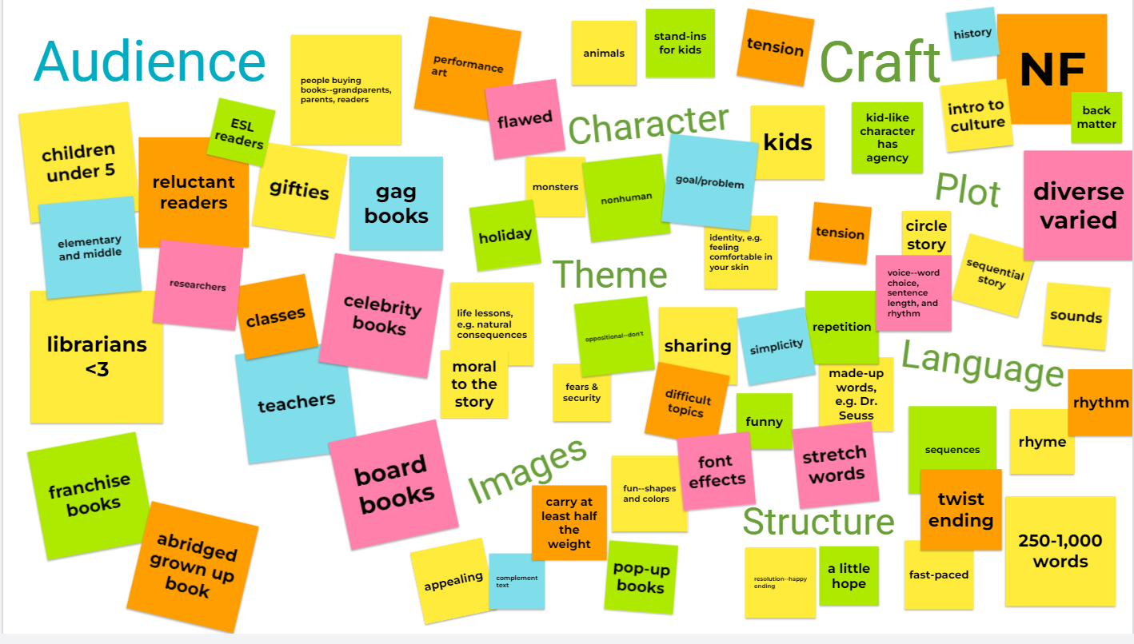

Slide 6
Audience(s) and
Purpose(s)

Slide 7






Children aren’t a monolith
AUDIENCE

Slide 8
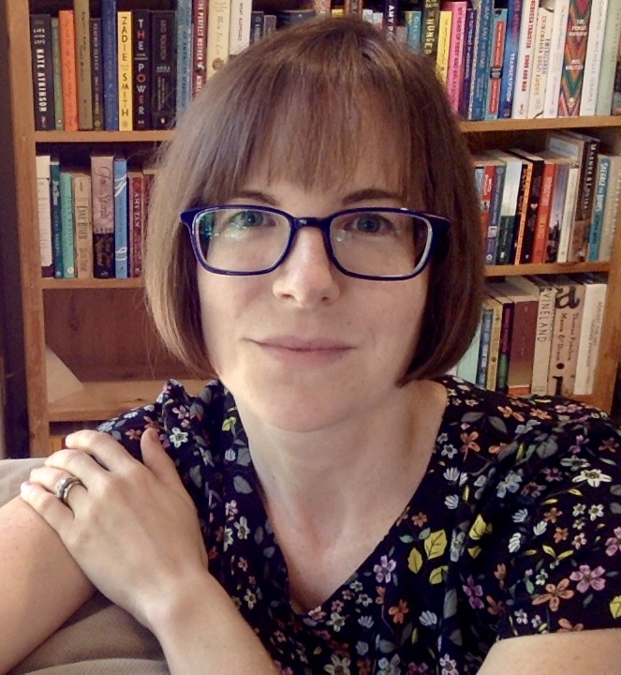
Kaylan Adair, Candlewick Press, SCBWI 2020
Picture Books (ages 0-6, 6-10)
Read aloud
Good prevails
Adults helpful
Language focus
Middle Grade (8-12)
Friend groups
Naïve narrator surprised to find people disappointing
Exposes flaws in adults
G/PG language
YA (14 and up)
Difficult subjects—finances, drugs, pregnancy, peer pressure
Teens solve problems without adults
Jaded narrator
Identity
R language
Young Readers (4-6)
Bridge PB and chapter books
Short fun/funny
Emerging readers
“Upper” Middle Grade (12-14)
More mature & difficult topics, e.g. death
Kids solve problems with or without adults
Less naïve but hopeful narrator
PG/PG-13 language
“New Adult” (17+)
Is this a category?
Hard-core YA
Darker endings
Chapter Books/
Early Novels (5-8)
Bridge PB and chapter books
Less white space & art
More adventure

Slide 9









AUDIENCE(S)
Who buys
and reads
and uses
picture books?

Slide 10
PURPOSE
Make sense of the world
How does it work?
What’s my place in it?
Teach
Vocabulary
Sequencing
Facts
Morals
Love of books
Entertain

Slide 11
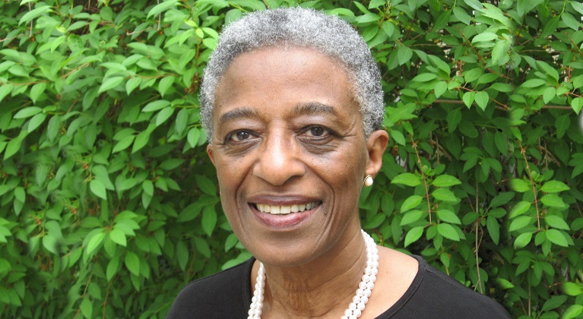
Books are sometimes windows, offering views of worlds that may be real or imagined, familiar or strange. These windows are also sliding glass doors, and readers have only to walk through in imagination to become part of whatever world has been created and recreated by the author. When lighting conditions are just right, however, a window can also be a mirror. Literature transforms human experience and reflects it back to us, and in that reflection we can see our own lives and experiences as part of the larger human experience. Reading, then, becomes a means of self-affirmation.
~Dr. Rudine Sims Bishop, 1990

Slide 12
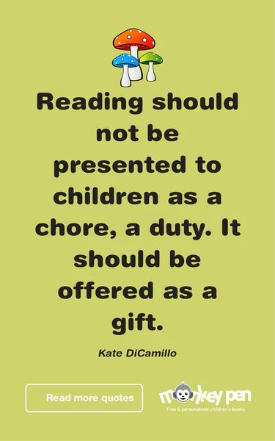

Slide 13
Types of Picture Books

Slide 14
Fiction
Nonfiction
Other
Story books
--character driven
--plot driven
--bedtime books
Concept books
--weather
--numbers
--shapes
--alphabet
Board books
History
--biography
--periods
Poetry anthologies
Interactive books
Science--STEM
Retold fairy tales, legends, etc.
Wordless books
Issue books
--civics
--diversity
Pop-up books
Seasonal/holiday books
Puzzle books
How-to books
List books

Slide 15

Time check

Slide 16
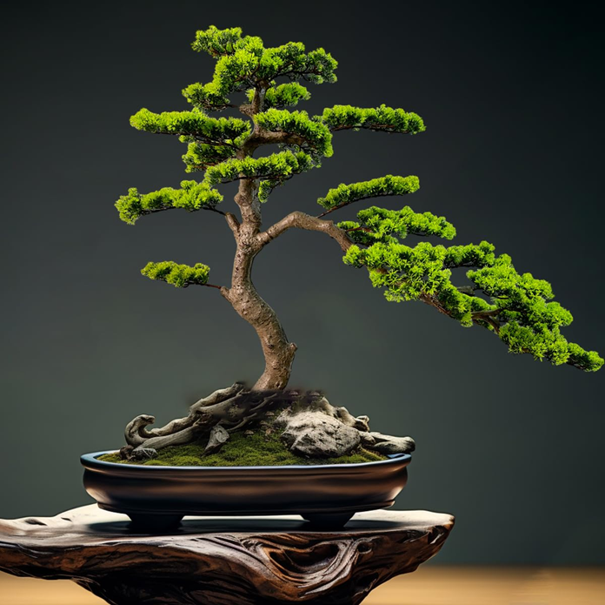
STORY

Slide 17
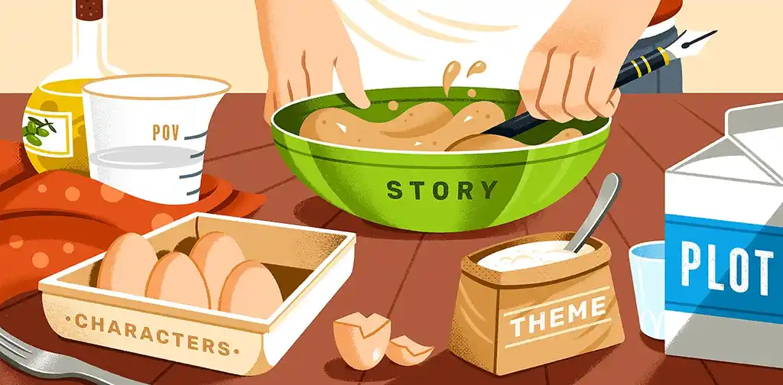

Illustrator

Slide 18
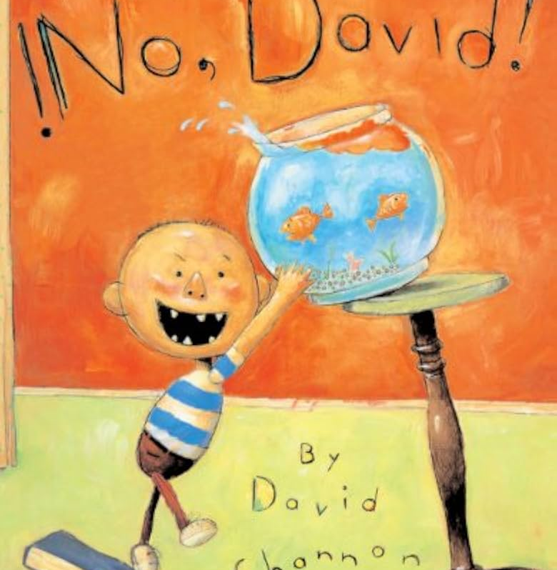
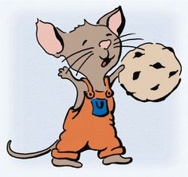
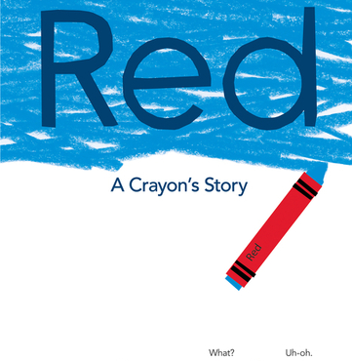
Characters
Kid
Animal
Nonhuman

Slide 19
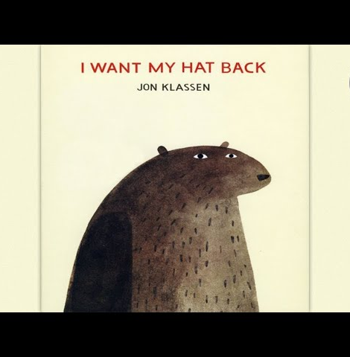
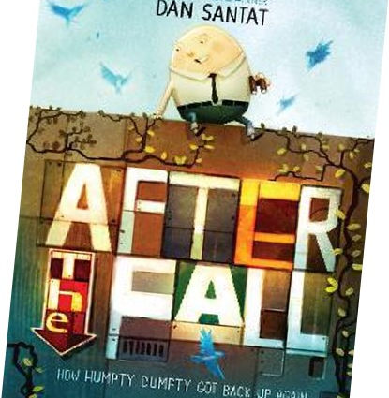

Plot—beginning, middle, end
Starts fast
Introduces protagonist
Presents want/goal or problem to solve
Shows protagonist trying and often failing (agency)
Ends with hope
Reveals character growth
Mirrors beginning (often)

Slide 20


Slide 21
LANGUAGE
Every word counts.
Less is often more.

Slide 22
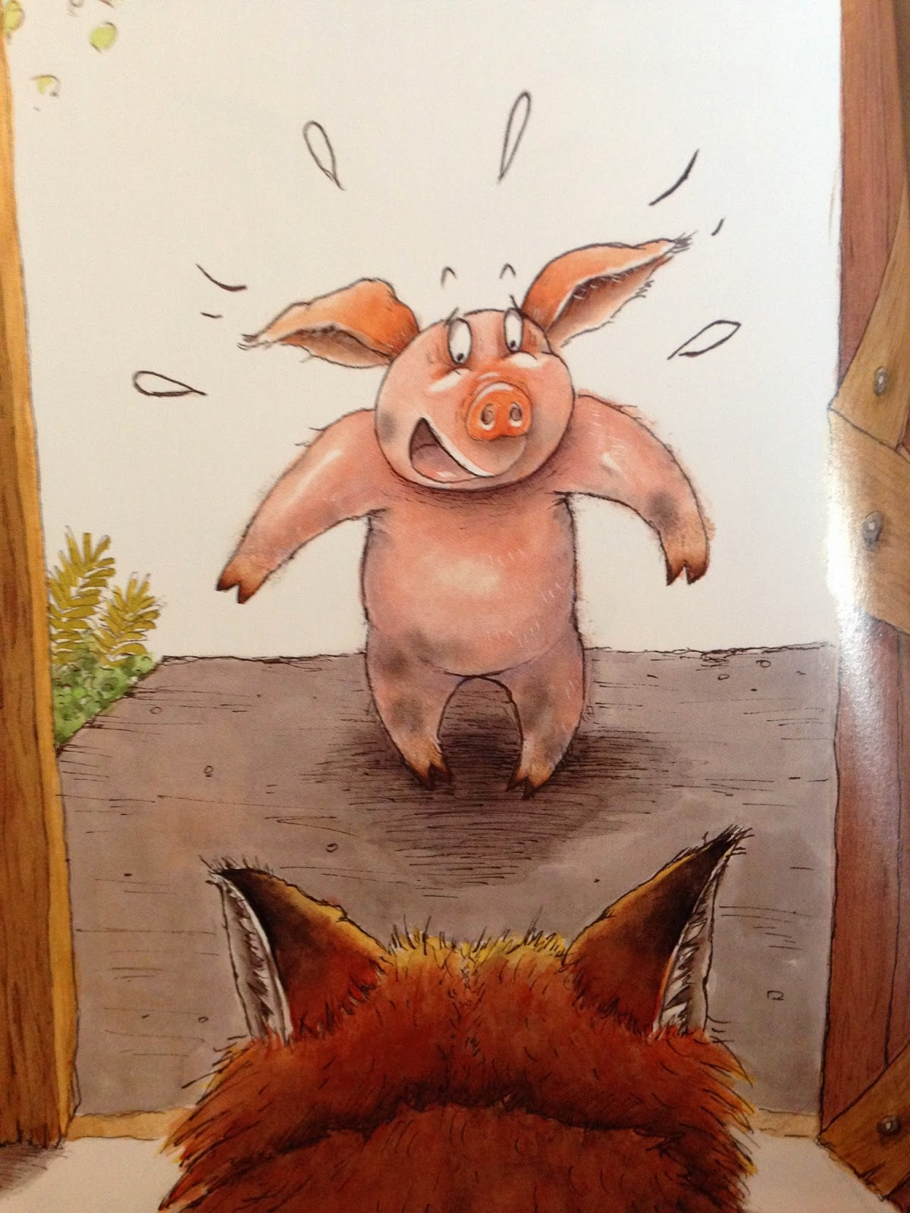
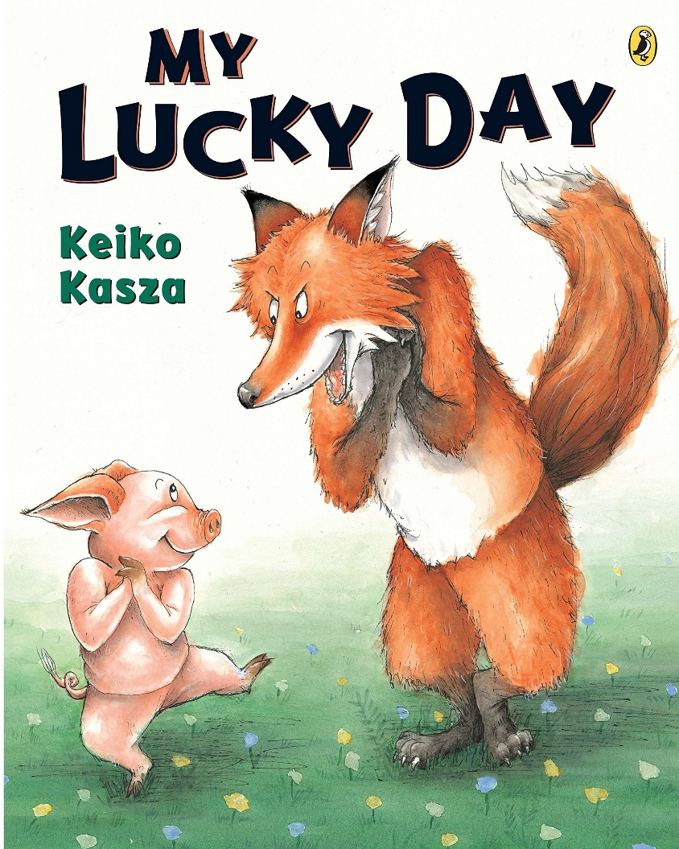
Trust the illustrator (and reader)
Images can amplify emotion and complement the verbal storytelling
From My Lucky Day

Slide 23
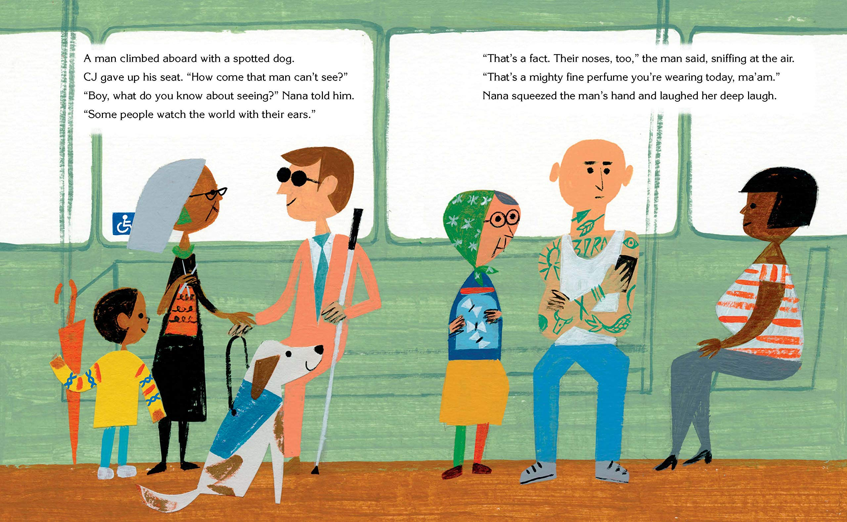
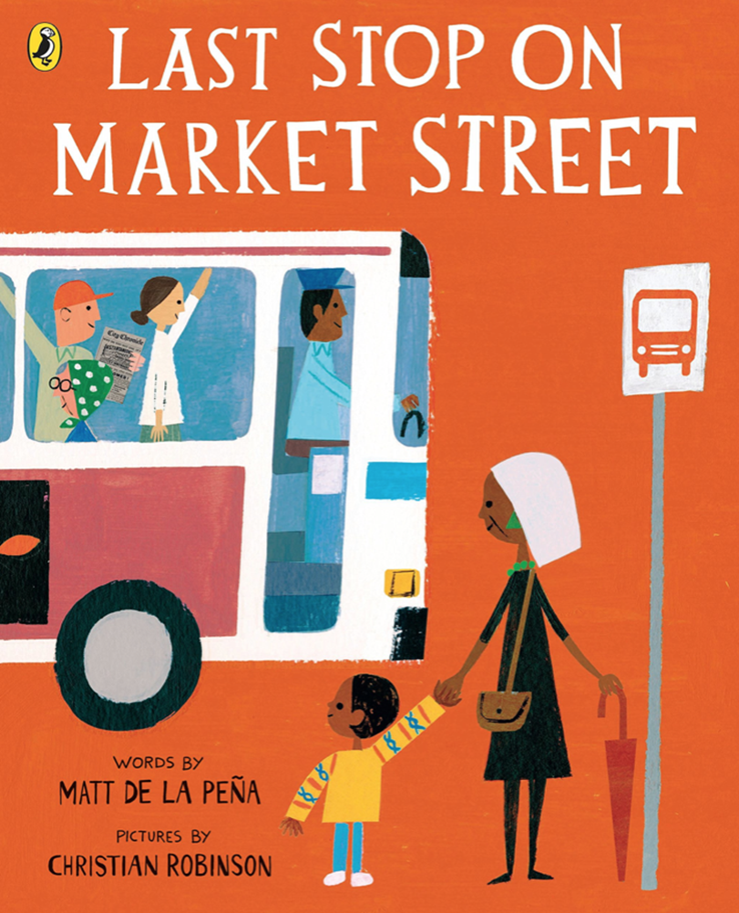
Create space –and inspiration – for the illustrator
Dedicate words for what text can do that images can’t
actions
smells
sounds
dialogue
From The Last Stop on Market Street

Slide 24
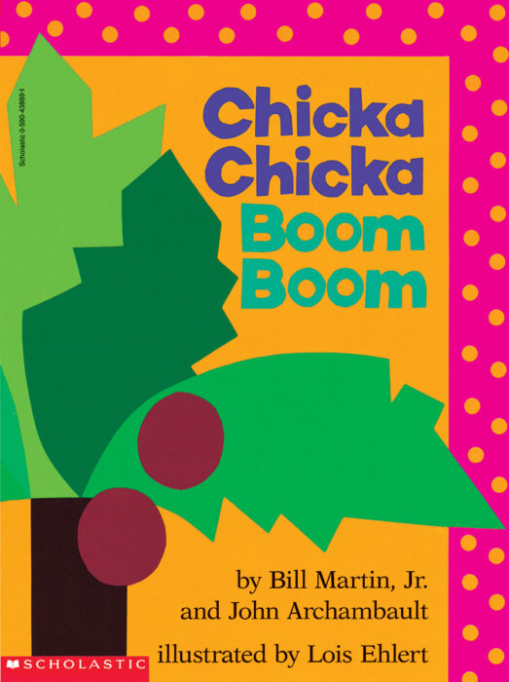
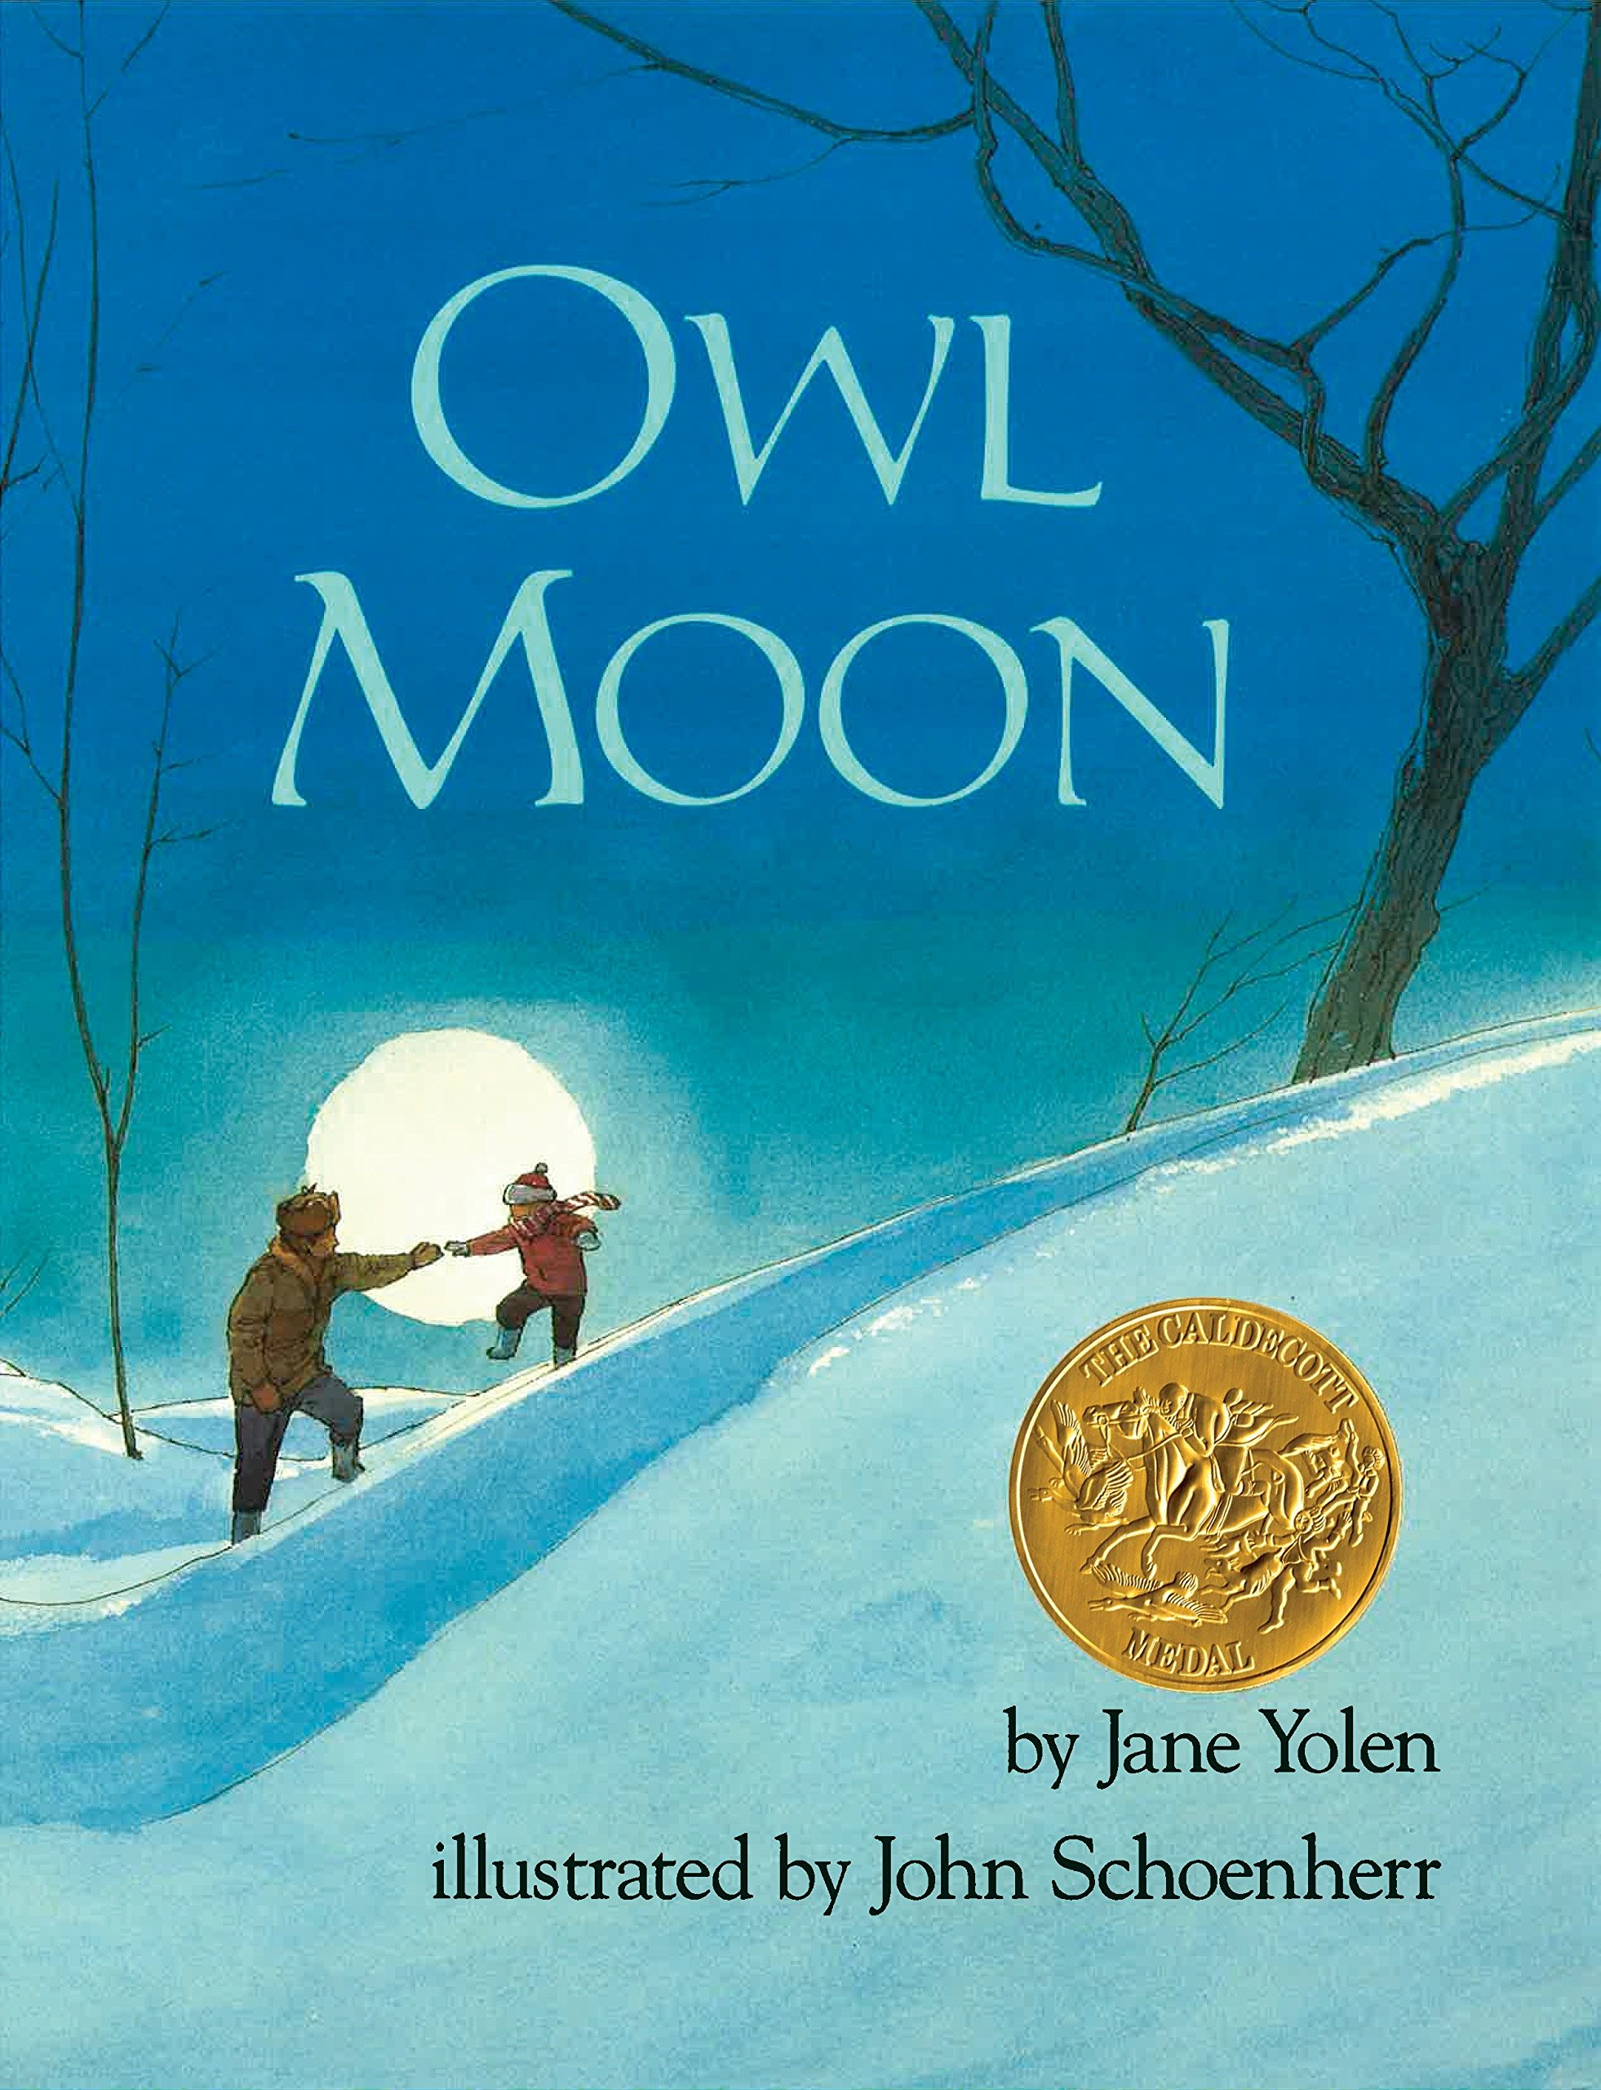
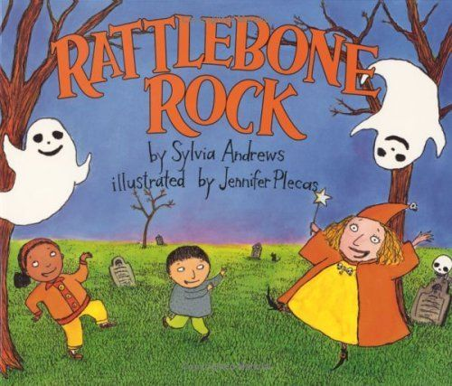
lyrical
rhyming
rhythmic

Slide 25
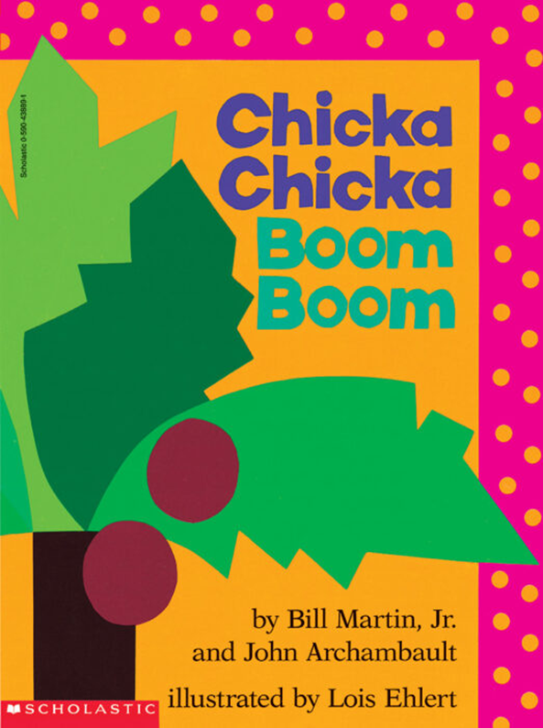
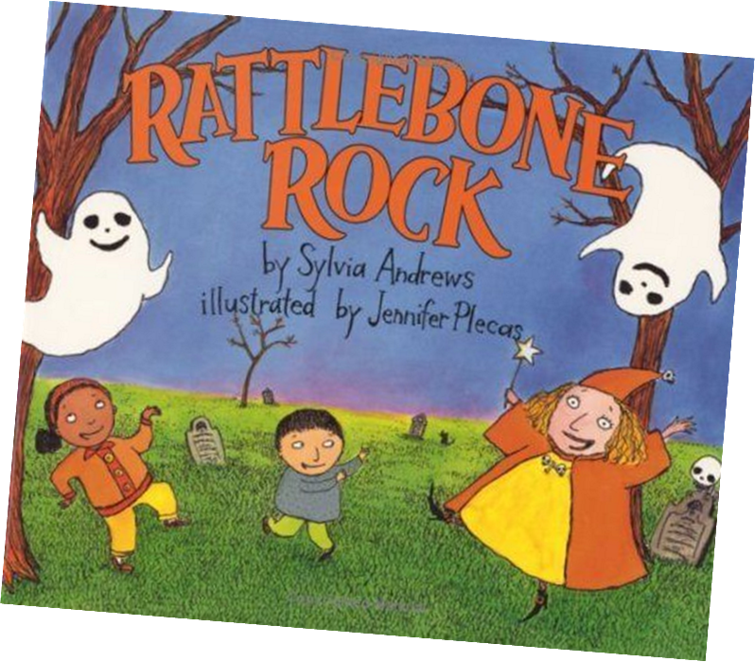
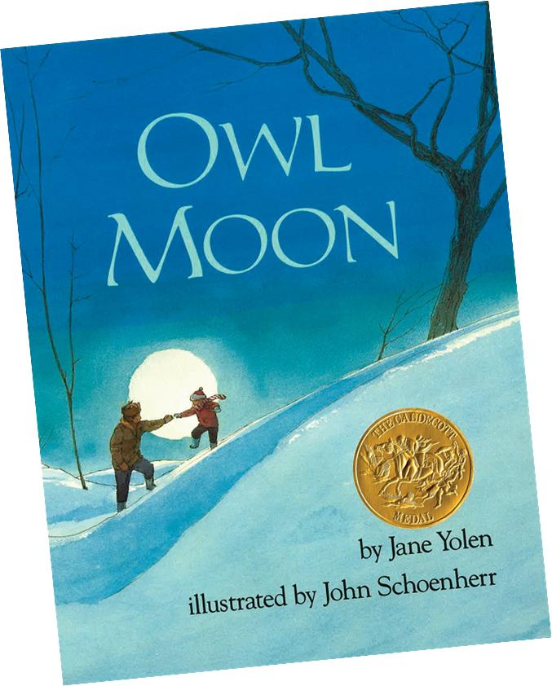
We went into the woods. The shadows were the blackest things I had ever seen. They stained the white snow. My mouth felt furry, for the scarf over it was wet and warm.
A told B and B told C, “I’ll meet you at the top of the coconut tree.”
“Whee!”said D to E F G, “I’ll beat you to the top of the coconut tree.”
Ghosts swayed in line
To the beat of the bones
And jazzed up the sound
With musical moans
Ooooa-ooo!
Boooa-boo!

Slide 26
Language tips
Don’t
Do
Imitate Dr. Seuss
Prioritize rhyme over story
Change the normal order of words to accommodate rhyme.
  To the playground was where they went. Because the best times there were spent.
Assume rhyme is the only way to play or to please with language
Incorporate poetic devices
  Metaphors
  Sound effects
  Onomatopoeia
  Assonance, consonance, alliteration
  Purposeful repetition
Use simple, powerful verbs
Read your text aloud

Slide 27
Time check

Slide 28
WRITING EXERCISE(S)

Slide 29
Character driven story
Think of a character—human (age), animal, or nonhuman.
What’s their goal/want/problem to solve?
What stands in their way?
How can they show agency?

Slide 30
Guided brainstorming
You were a child once.
Freewrite to prompts.

Slide 31
Q&A

Slide 32
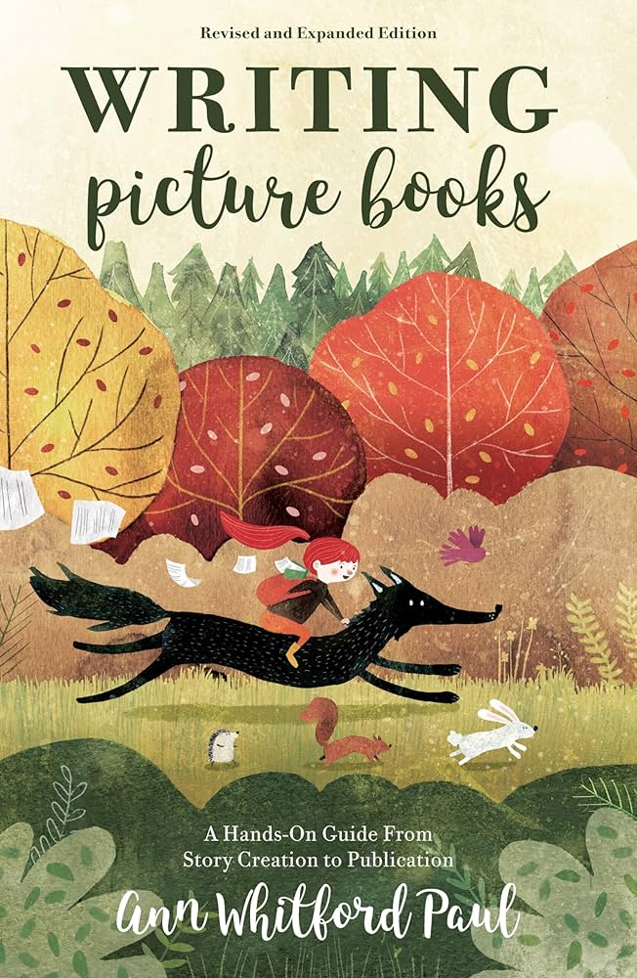
A Few Recommended Mentor Texts
Fiction
Little Red Writing by Joan Holub
(fractured fairy tale)
Last Stop on Market Street by Matt del Pena
The Day You Begin by Jacqueline Woodson
Hot Dog by Doug Salati
Nonfiction
Fry Bread: A Native American Story by Kevin Noble Maillard
Ida Always by Caron Levis
Hawk Rising by Maria Gianferrari
Cubs in the Tub: The True Story of the Bronx Zoo’s First Woman Zookeeper
by Candace Fleming
Craft: Writing Picture Books
by Ann
Whittford Paul

